Slide 1
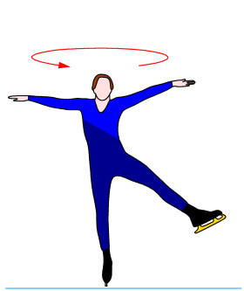
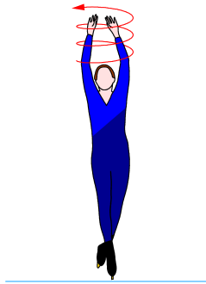
Rotational Dynamics
1st year physics laboratories
University of Ottawa Brightspace Lab website https://uottawa.brightspace.com/d2l/home

Slide 2
INTRODUCTION
Newtonian dynamics tells us that net force is proportional to acceleration $F=ma$.
For an object that is free to rotate, consider the rotational analogue: $\boxed{τ=Iα}$
The moment of inertia for a cylinder is given by: $\boxed{I=MR^{2}/2}$ where $M$ and $R$ are the mass and the radius of the cylinder.
( torque = moment of inertia × angular acceleration )

Slide 3
Part 1 – MOMENT OF INERTIA
We can experimentally determine the moment of inertia of an object by applying a known torque and measuring the angular acceleration.
You will apply a series of torques to a disc due to a hanging mass and measure corresponding the angular accelerations of the disc. Repeat for a double disc and rod with masses.
A plot of $τ$ vs $α$ will be used to graphically determine $I$.

Slide 4
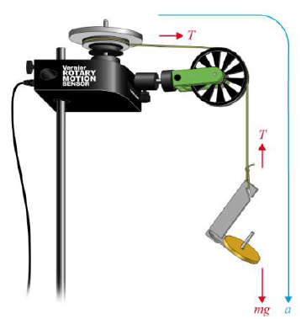
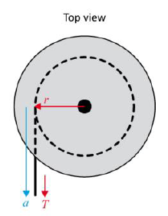
Part 1 – MOMENT OF INERTIA
The rotational sensor measures $θ$ vs $t$.
Measure angular accelerations for different torque values:
Angular acceleration can be found from the slope of the angular velocity vs time plot.
The Torque applied to the disc can be found: $\boxed{τ=rT}$ $T$ is tension of hanging mass.
Using Newton’s 2nd law: $F=ma=mg−T$ $\boxed{τ}=rm\left(g−a\right)=\boxed{mr\left(g−αr\right)}$.

Slide 5
Part 1 – MOMENT OF INERTIA
Important information needed:
Diameter of rotating horizontal pulley (black), mass and diameter of the first aluminum disc.
Setup experiment as shown in picture on next slide. Attach string to black pulley on the sensor and hang it over the green pulley. Attach the mass hanger to the end of the string.
Wind the large pulley and collect data (5 s) as the mass hanger accelerates the aluminum disc.
Perform a linear fit on the $ω$ vs $t$ graph to get angular accel.
Repeat the measurement for increasing masses.

Slide 6
The setup for rotating discs

Slide 7
A Closer Look…

Slide 8
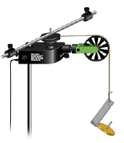
Part 1 – MOMENT OF INERTIA
Find the mass of the second aluminum disc (the one with cork padding).
Repeat the experiment with both aluminum discs attached to the sensor (double disc).
Find the masses of the rod and weights then attach them to the sensor.
Repeat the experiment for the rod and weights (use 20 s data collection).

Slide 9
The setup for rotating rod and masses

Slide 10
Part 2 – Cons. of ang. momentum
Similar to the linear momentum experiment, you will investigate how the angular momentum of a rotating system is affected by a change in the moment of inertia.
You will measure the angular speed of a rotating disc before ($ω$) and after ($ω^{′}$) a completely inelastic collision.
The equations to calculate the angular momentums before and after the collision are: $\boxed{L=I_{1}ω}$ $\boxed{L^{′}=I_{1}ω^{′}+I_{2}ω^{′}}$

Slide 11
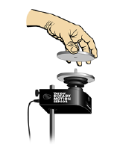
Part 2 – Cons. of ang. momentum
Mount your first aluminum disc to the pulley (same as first section of Part 1).
Spin the first disc. You’ll notice the velocity decreasing gradually.
Position the second disc over the screw and practice dropping it onto the first.
Collect the angular velocity data of the system before ($ω$) and after ($ω^{′}$) the collision.

Slide 12
CLEAN UP
DUE DATE
Turn off the computer, and don’t forget to take your USB key.
Put the discs, rod, and weights on the table.
Please recycle scrap paper and throw away any garbage. Please leave your station as clean as you can.
Push back the monitor, keyboard, and mouse. Please push your chair back under the table.
Thank you!
The report is due at the end of the lab session.
Make sure you submit your graphs in Brightspace before leaving!
Notes:
Comments for TAs: leave this slide on the TV monitors when you are not using them for teaching.

