Slide 1
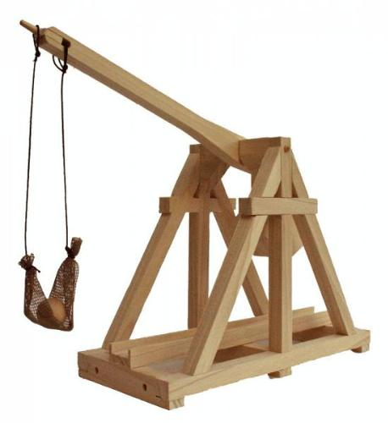
Projectile motion
1st year physics laboratories
University of Ottawa Brightspace Lab website https://uottawa.brightspace.com/d2l/home

Slide 2
INTRODUCTION
In this experiment you will investigate kinematics in 2D with the use of a projectile launcher.
The two important values for launch are the initial velocity ($v0$) and the launch angle ($θ$)
You will study the range of a projectile for a given $v0$ and $θ$, the conservation of energy for the launched item, and you will be challenged to hit a stationary target for a portion of your marks!

Slide 3
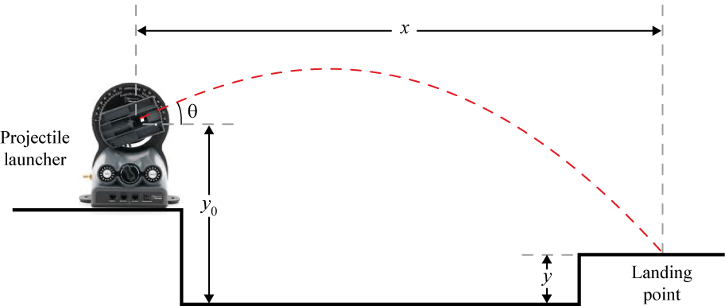
PROJECTILE RANGE
We can separate the equation of motion for a projectile launched at an angle $θ$ into its $x$ and $y$ coordinates:
$y=y_{0}+\left(v_{0}\sin{θ}\right)t−\frac{1}{2}gt^{2}$
$x=\left(v_{0}\cos{θ}\right)t$

Slide 4
CONSERVATION OF ENERGY
The total mechanical energy of a projectile is the sum of its kinetic ($K$) and potential ($U$) energies.
When a projectile is shot straight up,
$U_{0}=0$ and $K_{0}=\frac{1}{2}mv_{0}^{2}$
When the projectile reaches its max.height ($h$)
$U=mgh$ and $K=0$
Note that we defined $h=0$ at the launching point.

Slide 5
SAFETY CONSIDERATIONS
Don’t stare down the barrel of a loaded projectile launcher, EVER.
Please wear your safety goggles while shooting projectiles.
If you’re bad at catching, don’t try to catch the launched projectile and accidentally swipe it into your partner’s (or the TA’s) face…

Slide 6
THE FULL SETUP
Wooden box
Foam mat
Time of flight pad
Launcher

Slide 7
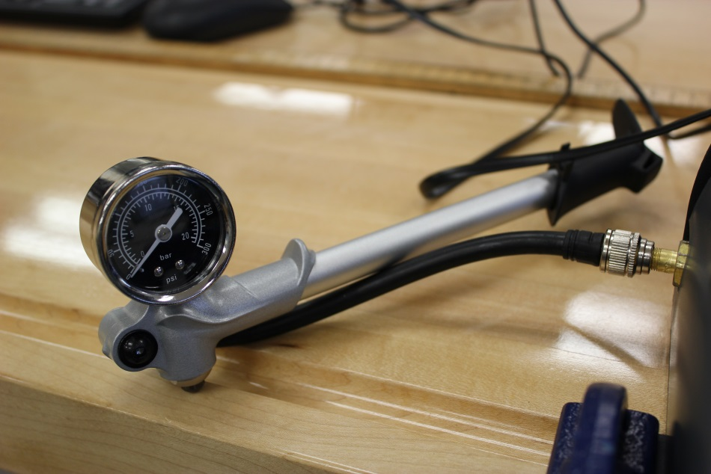
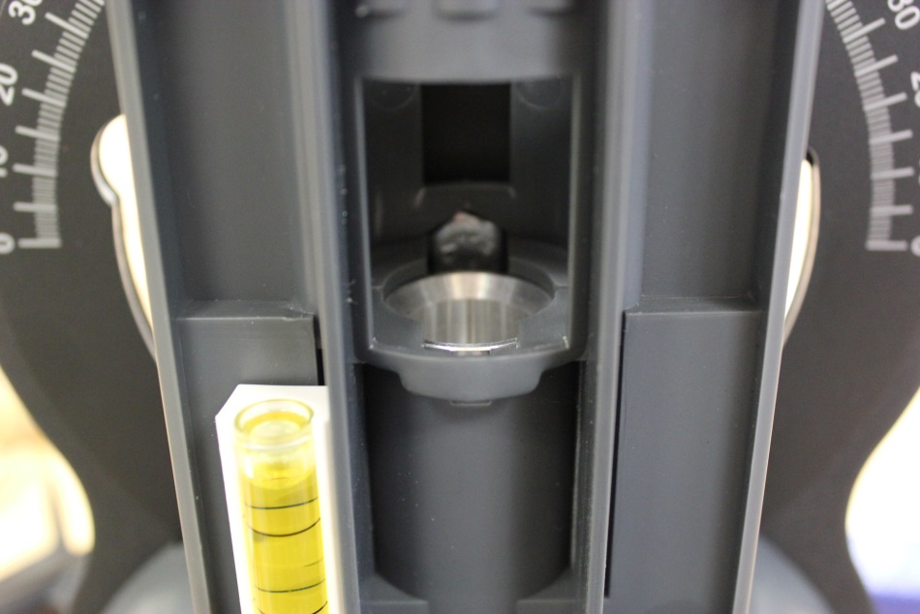
THE PUMP AND THE BARREL

Slide 8
LEVELING THE LAUNCHER
Make sure the launcher is securely fastened to the table, we don’t want it landing on anyone’s foot (the launcher might break!!)
Using the lower knob on the back of the unit and the small yellow level, adjust the angle of the launch chamber so it’s perfectly horizontal (pointing towards the end of the table).
Using the upper knob, adjust the angle markings so that zero is aligned with the center of your launch chamber.

Slide 9
PRACTICE LAUNCHING
Open the LoggerPro program, make sure the pump is connected to the launcher, set your angle to $θ$ = 45°, then put the ball in.
PUT YOUR GOGGLES ON!
Using a pressure of ~40-50 PSI, practice launching the ball. It should land around ~30 cm from the end of the table. Adjust the pressure, if necessary.
LoggerPro will give you the initial velocity of the ball.

Slide 10
TIME OF FLIGHT (TOF)
You will calculate time of flight for a specific trajectory where $y=y_{0}$ and $θ$ = 45°.
The time of flight is given by $t=\frac{2v_{0}\sin{θ}}{g}$
The horizontal distance is $x=\left(v_{0}\cos{θ}\right)t$
Put the time of flight pad into the right location, obtain the experimental TOF and compare it with your calculated value.

Slide 11
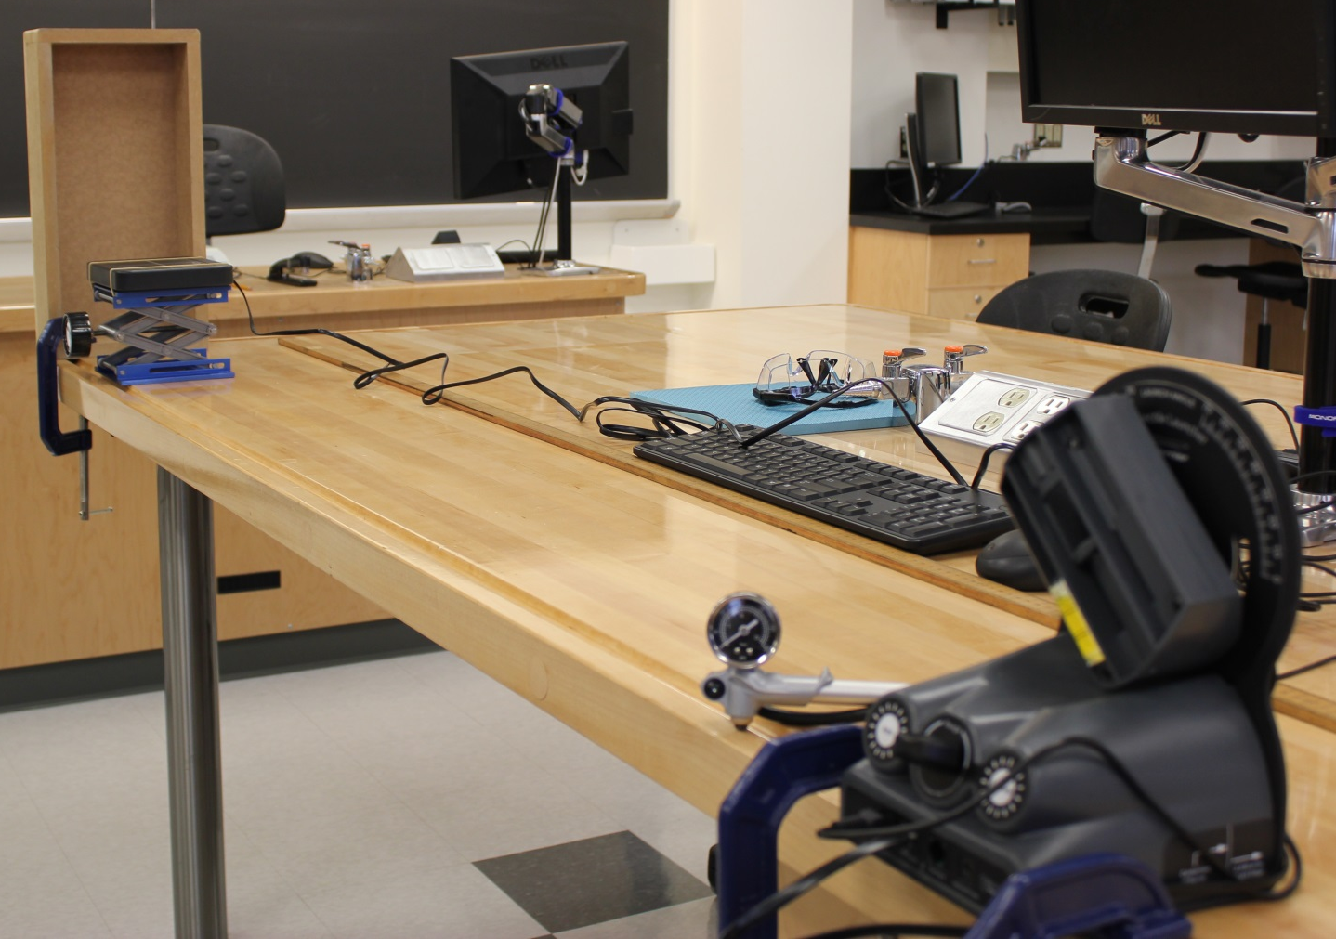
TIME OF FLIGHT SETUP
Wooden box
Time of flight pad
Launcher

Slide 12
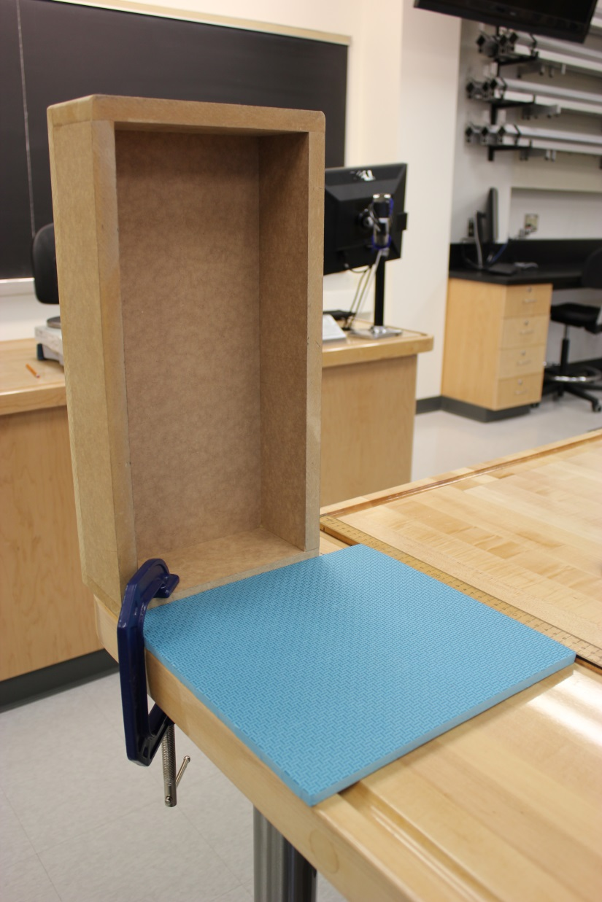
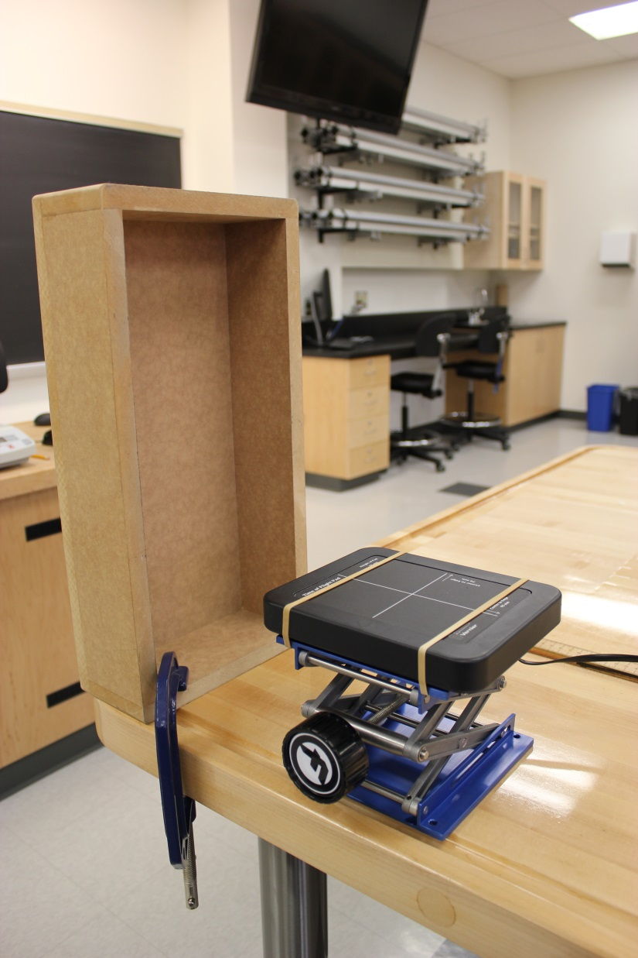
ZOOM VIEW

Slide 13
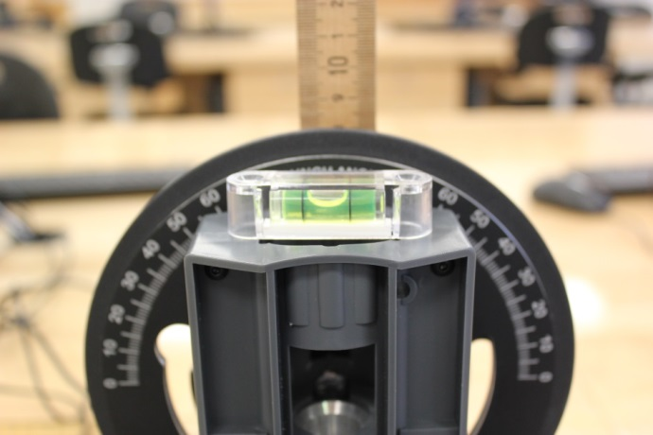
CONSERVATION OF ENERGY
Use the small yellow level to angle the launcher to vertical ($θ$ = 90°).
Calculate maximum theoretical height.
Shoot the ball and estimate the maximum height it reached using the meter stick setup.
Try to catch the ball before it hits the launcher.
Compare your theoretical values of U and K with experimental ones.

Slide 14
YOUR CHALLENGE if you choose to accept it…
Your TA will set the height of the target (between 20 and 25 cm) and the angle of your launcher (between 50° and 70°).
You will calculate the horizontal distance, $x$, where the target should be placed so it will be hit.
Position your target and ask your TA to return. Fire your projectile 3 times. You get max points if you hit the target at least 2/3 times. Half points if you hit the target 1/3 times.
NO PRACTICE SHOTS ALLOWED. IF YOU ARE CAUGHT PRACTICING, YOU WILL GET ZERO FOR THIS SECTION.

Slide 15
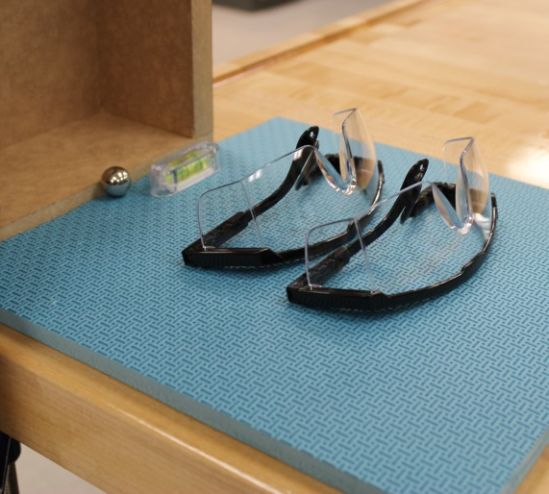
CLEAN UP!
DUE DATE
Turn off the computer.
Put back together the steel ball, the level, the foam mat and the goggles near the wooden box.
Push back the time of flight pad towards the center of the table. Also push back the meter stick/support assembly.
Please recycle scrap paper and throw away any garbage. Please leave your station as clean as you can.
Push back the monitor, keyboard, and mouse. Please push your chair back under the table.
The report is due at the end of the lab session, i.e., at 12:50pm or 5:20pm.
Don’t forget to do your pre-lab for the next experiment!
PRE-LAB
Notes:
Comments for TAs: leave this slide on the TV monitors when you are not using them for teaching.

