Slide 1
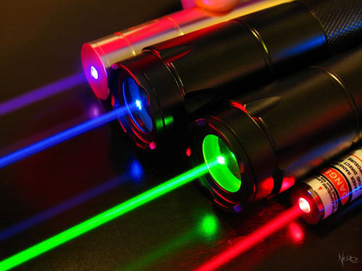
Physical Optics
1st year physics laboratories
University of Ottawa
https://uottawa.brightspace.com/d2l/home

Slide 2
INTRODUCTION
Physical optics deals with light as a wave which can bend around obstacles (diffraction) and constructively or destructively interfere (interference).
Visible light has a very short wavelength (~400 – 700 nm) therefore its wave-like properties can be difficult to observe.
In today’s experiment, you will examine various wave-like properties of light such as:
Diffraction from a single slit / double slit / grating
Dispersion of light using a grating
Diffraction around a spherical obstacle
Attenuation of light using polarizers

Slide 3
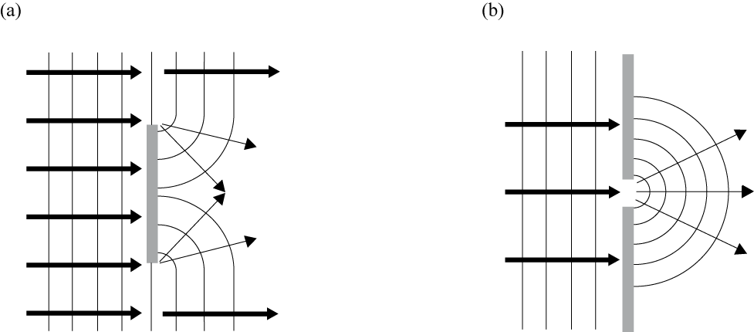
INTRODUCTION (cont.)
Light waves being blocked by an obstacle can bend around it much like water or sound waves.
If a narrow slit is placed in front of an incident wave, a new wave will spread out on the opposite side as if the slit were a point source of waves.

Slide 4
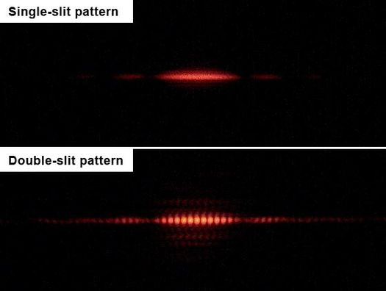
DIFFRACTION PATTERN
The interference of light waves by diffraction through a single slit, double slit, or diffraction grating will cause a pattern of bright (constructive) and dark (destructive) spots when imaged on a screen.
To best observe diffraction and interference, we use a monochromatic and coherent light source.
If the size and spacing of the slits are known, we can calculate the wavelength of the light using some simple formulas.

Slide 5
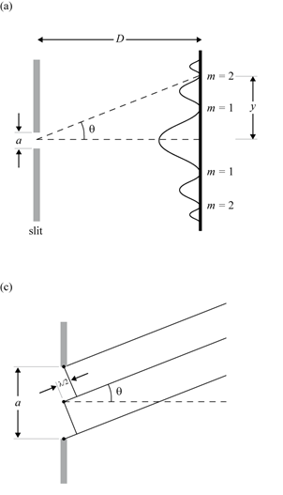
DIFFRACTION FROM A SINGLE SLIT
For light passing through a single slit, Huygen’s Principle explains that any point within the slit acts as a new source of emitted waves.
The equation for the angle to the minima in the interference pattern is given by: $a\sin{θ}=mλ (m=1, 2, 3…)$
Using the small angle approximation and trigonometry, we can solve for the slit width: $a= \frac{mλD}{y} \left(m=1, 2, 3…\right)$

Slide 6
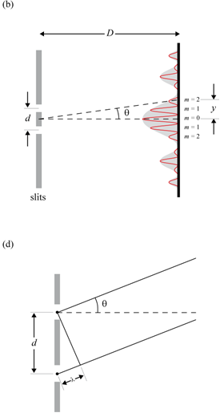
INTERFERENCE FROM A DOUBLE SLIT
An incident wave passing through a double-slit will spread out on the opposite side as two new sources of emitted waves, ready to interact with each other.
The equation for the angle to the maxima in the interference pattern is given by: $d\sin{θ}=mλ \left(m=0, 1, 2, 3…\right).$
Using the small angle approximation and trigonometry, we can solve for the slit distance:$d= \frac{mλD}{y} \left(m=0, 1, 2, 3…\right)$

Slide 7
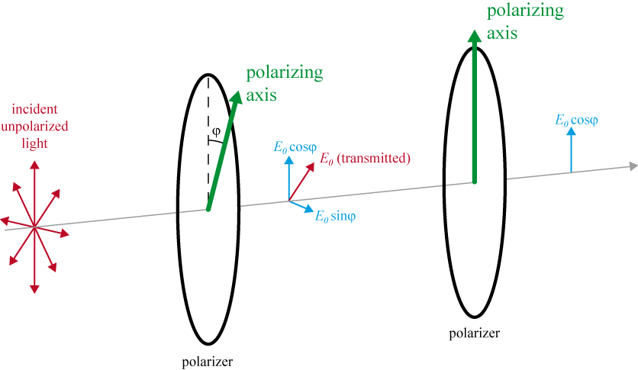
POLARIZATION
A polarizer will only allow light which is vibrating in a particular plane or “axis” of polarization to pass through it.
The portion of unpolarized light (vibrating in all planes) that passes through the polarizer becomes polarized in this axis.
If polarized light is sent through a 2nd polarizer, the intensity of light transmitted is given by Malus’ Law: $I=I_{0}\cos^{2}{φ}$ where $I_{0}$is the intensity of light passing through the first filter and $φ$is the angle between the axes of the two polarizers.

Slide 8
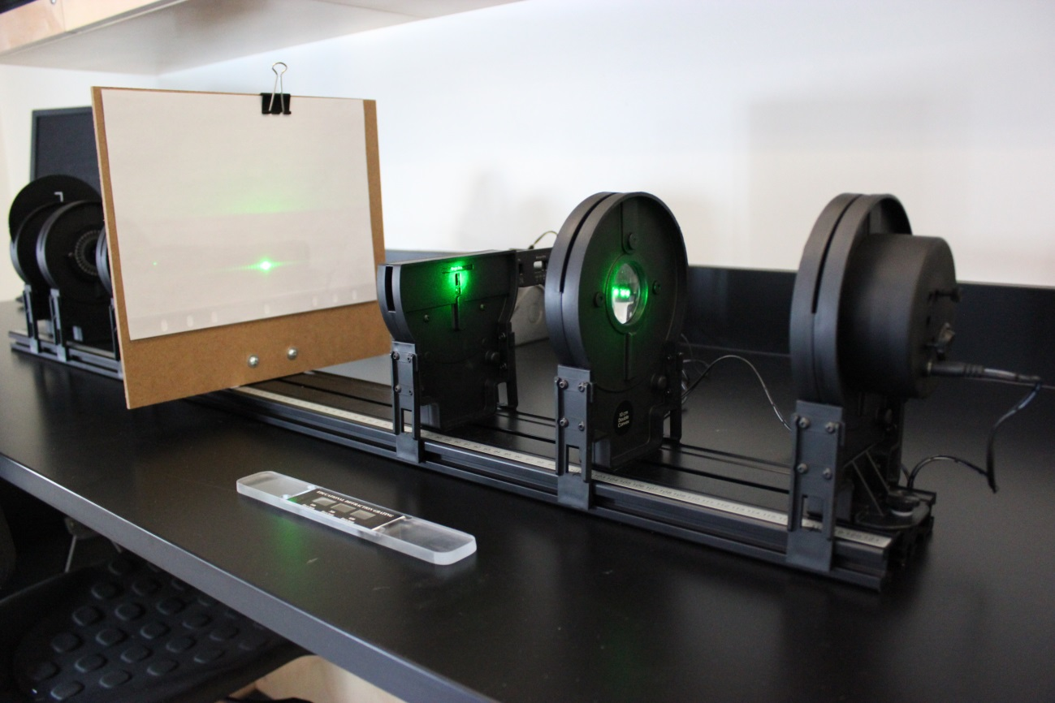
SETUP: DIFFRACTION FROM A SLIT
diffraction slit assembly
screen
lens
diffraction
gratings
laser

Slide 9
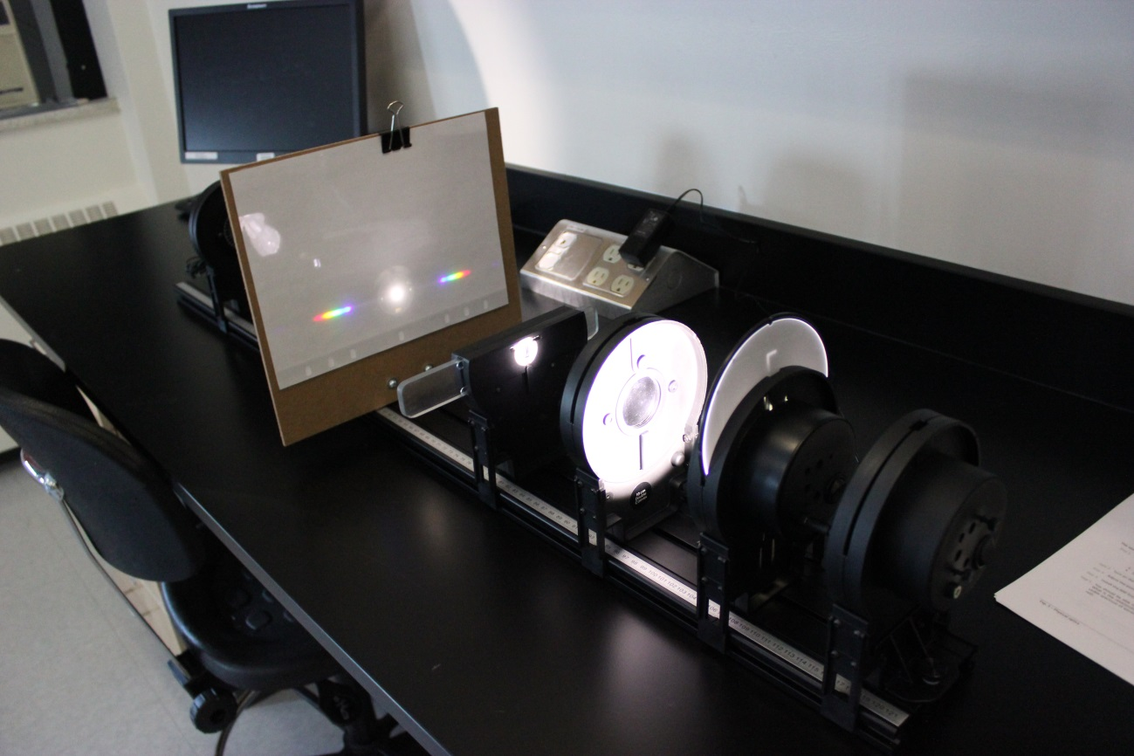
SETUP: DISPERSION FROM A GRATING
Laser (turned off)
screen
gratings
lens
white light

Slide 10
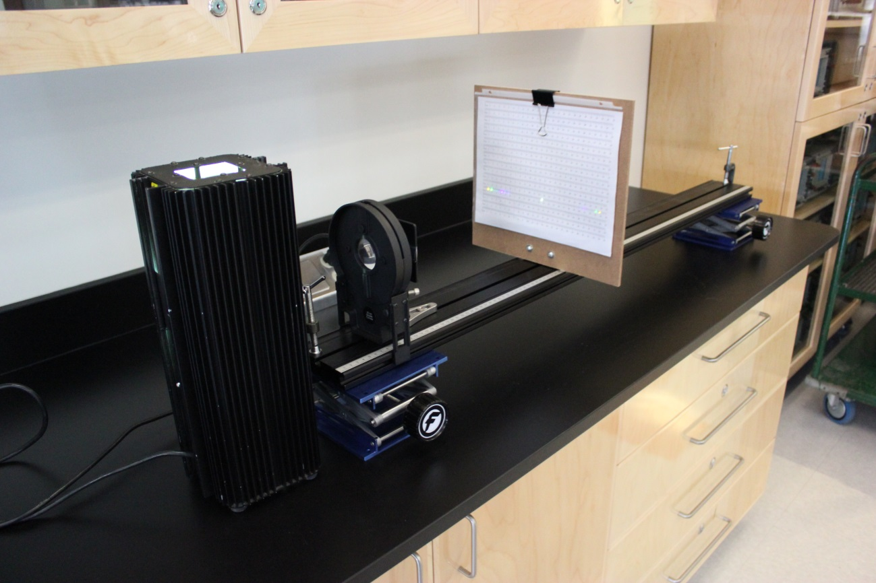
SETUP: SPECTRUM OF A MERCURY LAMP (1 per class)
screen
lens & gratings
mercury lamp

Slide 11
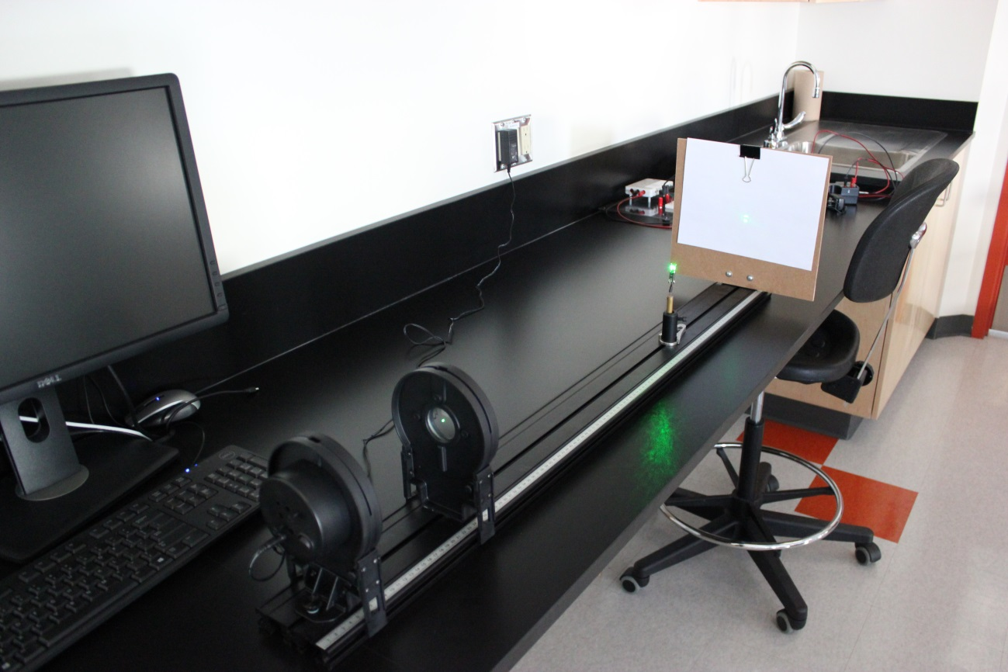
SETUP: DIFFRACTION AROUND AN OBSTACLE
1 PER CLASS
screen
bead
lens
laser

Slide 12
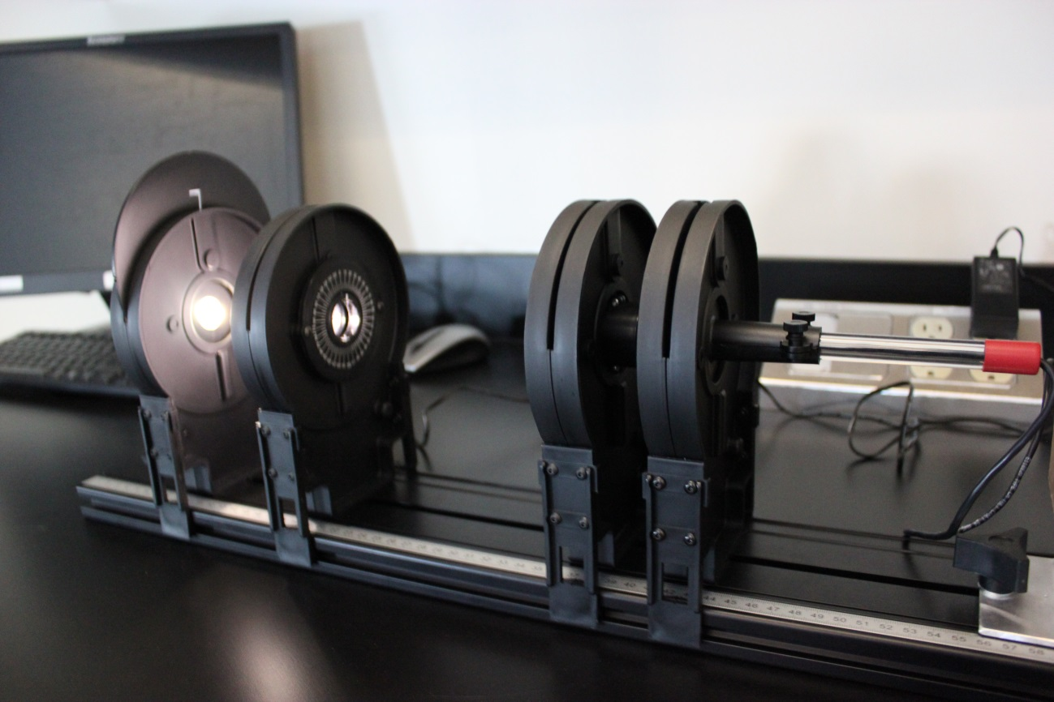
SETUP: POLARIZATION OF LIGHT
light sensor
white light
polarizer 1
polarizer 2

Slide 13
CLEAN UP
DUE DATE
The report is due at the end of the lab session.
Turn off the computer and don’t forget to take your USB key.
Make sure the laser and the white light source are turned off.
Leave the following components on the optical track in that order: light source – polarizers (2) – light sensor – screen – diffraction slit assembly – laser. Leave the lens nearby the bench.
Please recycle scrap paper and throw away any garbage. Please leave your station as clean as you can.
Push back the monitor, keyboard, and mouse. Please push your chair back under the table.
You are about to complete your last physics lab for this semester!
Notes:
Comments for TAs: leave this slide on the TV monitors when you are not using them for teaching.

Slide 14
Equipment information: the laser
Your setup includes a red or green laser.
Red laser: wavelength of 636 nm.
Green laser: wavelength of 532 nm.
Laser Safety
This is a class 2 laser product.
Do not stare directly into the laser beam or its reflection.
Maximum output is < 1 mW.
A class 2 laser is generally considered safe as the blink reflex will limit exposure to short time periods. Most laser pointers are in this class. Direct exposure on the eye by a beam of laser light should always be avoided with any laser, no matter how low the power.

Slide 15
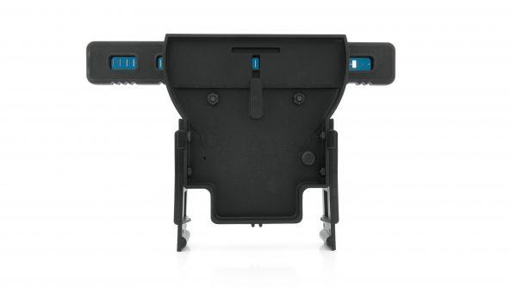
Equipment information: the slit assembly
Single slits | Variable slits | Double slits | Variable double slit | Multiple slits | Comparisons
• 0.02 mm • 0.04 mm • 0.08 mm • 0.16 mm | • Wedge: 0.02 – 0.2 mm wide • Double Slit: 0.04 mm wide, spacing 0.125 – 0.75 mm | • 0.04 mm wide, 0.25 mm apart • 0.04 mm wide, 0.5 mm apart • 0.08 mm wide, 0.25 mm apart • 0.08 mm wide, 0.5 mm apart | Same as variable slits | 4 sets: • 2, 3, 4, 5 slits • 0.04 mm wide at 0.25 mm apart | 4 pairs of single/double slits: • 0.04 mm single + 0.04/0.25 mm double, • doubles 0.04/0.25mm + 0.04/0.50 mm, • doubles 0.04/0.25 mm + 0.08/0.25 mm, • double 0.04/0.25 mm + triple, 0.04/0.25 mm

